Slide 1
BIPARTISAN INFRASTRUCTURE LAW (BIL) Discretionary Grants Resources
Andrea Gutierrez
FHWA Nevada Division
5/7/2024

Slide 2
Introductory Notes
This presentation:
focuses on the provisions in the BIL related to grants
provides an overview of grant programs and provisions, but it is not all inclusive
For more information, please visit the Federal Highway Administration’s BIL website: fhwa.dot.gov/bipartisan-infrastructure-law
Disclaimer: Except for any statutes or regulations cited, the contents of this presentation do not have the force and effect of law and are not meant to bind the public in any way. This presentation is intended only to provide information regarding existing requirements under the law or agency policies.

Slide 3
Highlights of BIL Highway Provisions
Funds highway programs for five years (FY 22-26)
$350.8 B (FY 22-26) for highway programs
$303.5 B in Contract Authority (CA) from the Highway Trust Fund (HTF)
+$47.3 B in advance appropriations from the General Fund (GF)
More than a dozen new highway programs, including─
Formula: resilience, carbon reduction, bridges and electric vehicle (EV) charging infrastructure
Discretionary: bridges, EV charging infrastructure, rural projects, resilience, wildlife crossings, and reconnecting communities (almost 50% Discretionary Funding)
Focus on safety, bridges, climate change, resilience, and project delivery
More opportunities for local governments and other non-traditional entities to access new funding
April 2023 FHWA “An Overview for our Stakeholders” can be found at:
highways.dot.gov/sites/fhwa.dot.gov/files/2023-04/overview-for-our-stakeholders.pdf
Notes:
The Bipartisan Infrastructure Law provides about $350B over five years. Among other important programs, BIL expanded old and introduced new discretionary grant programs.

Slide 4
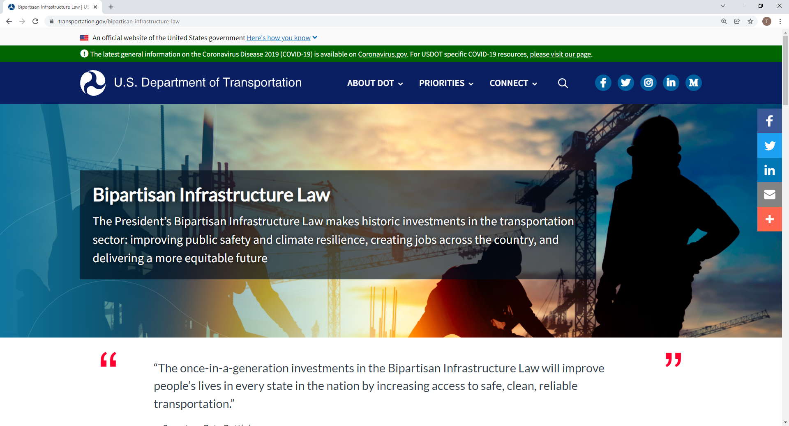
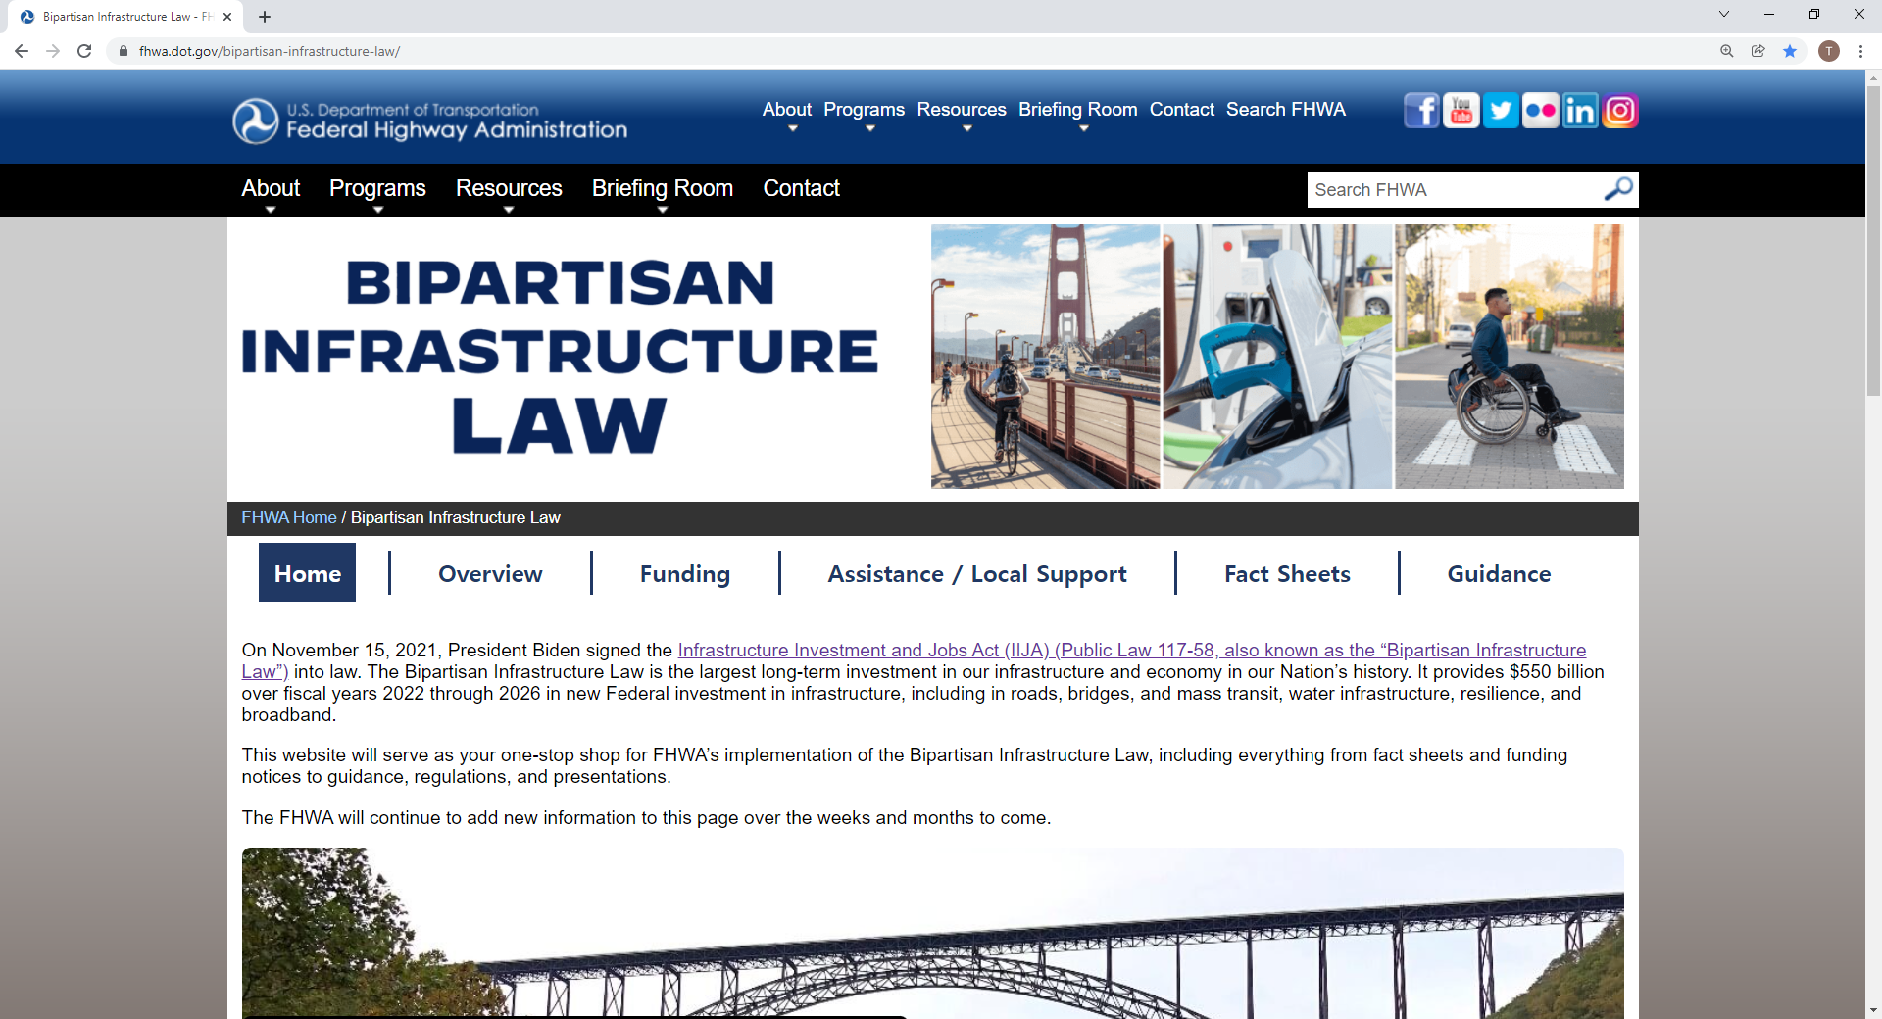
BIL Implementation Websites
“One-stop shop” implementation websites can be found at:
DOT-wide: https://www.transportation.gov/bipartisan-infrastructure-law
FHWA: https://www.fhwa.dot.gov/bipartisan-infrastructure-law/
Customer-oriented and public-facing
Updated over time with additional material
Notes:
The USDOT and FHWA has created their own “one-stop shop” websites that provide information and resources on BIL and its programs. All the links provided in this presentation can be found from these two websites. Not only can you find information on grants, but also on existing and new formula programs.

Slide 5
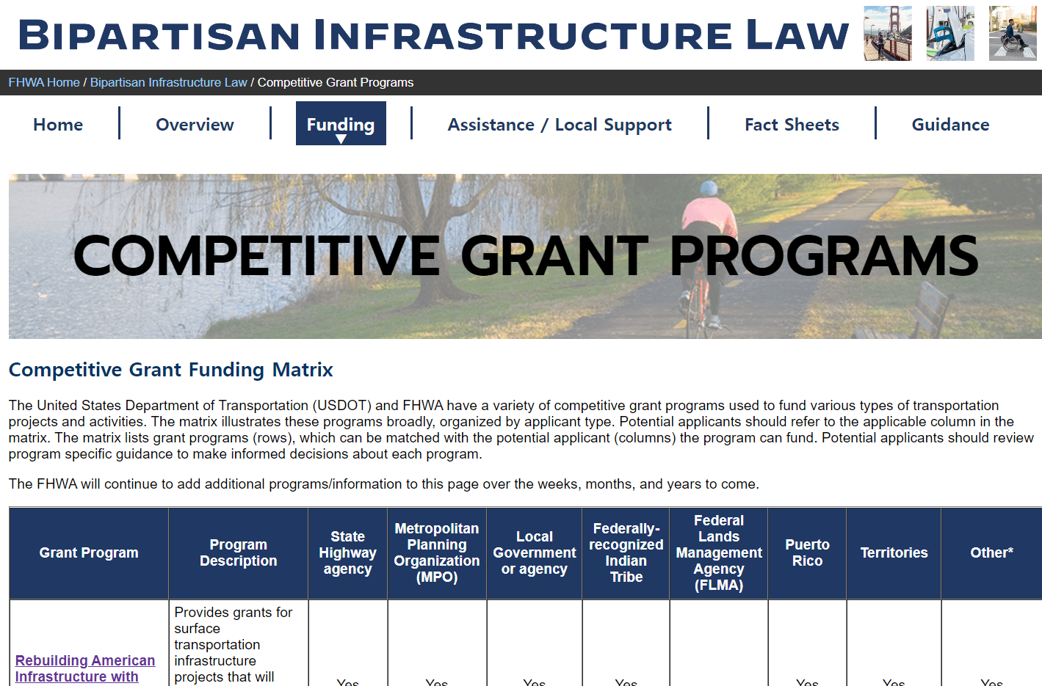
Discretionary Grant Programs
There are now over a dozen discretionary (grant) programs, including:
Reconnecting Communities
Safe Streets and Roads For All
RAISE
MEGA
RURAL
Bridge Investment Program
For a listing of competitive grant programs and eligible entities, visit:
DOT-wide: https://www.transportation.gov/bipartisan-infrastructure-law/bipartisan-infrastructure-law-grant-programs
FHWA: https://www.fhwa.dot.gov/bipartisan-infrastructure-law/grant_programs.cfm
Notes:
If you are looking specifically for all of the grant opportunities available under BIL, the USDOT and FHWA have listings for grants. The FHWA list will show you the grants that are administered FHWA while the USDOT list will includes grants from other agencies such as FTA, FRA, and OST. Please keep in mind that some grants that are administered by FHWA will be designated by OST and will be labeled under OST.

Slide 6
Funding Available to a Range of Recipients
Program Examples | State | PR* | MPO | Local | Tribe | PA** | Territory | FLMA**
Apportioned programs (formula) | ✓ | *
Bridge Program (formula) | ✓ | ✓ |  |  | ✓
National Electric Vehicle Formula Program | ✓ | ✓ |  | ✓
Safe Streets and Roads for All program |  |  | ✓ | ✓ | ✓
PROTECT Grants (discretionary) | ✓ | ✓ | ✓ | ✓ | ✓ | ✓ | ✓*** | ✓***
Charging and Fueling Infrastructure Program | ✓ | ✓ | ✓ | ✓ | ✓ | ✓ | ✓
Congestion Relief Program | ✓ | ✓ | ✓ | ✓
Bridge Investment Program (discretionary) | ✓ | ✓ | ✓*** | ✓ | ✓ | ✓ |  | ✓
Reconnecting Communities Pilot Program | ✓ | ✓ | ✓ | ✓ | ✓
Rural Surface Transportation Grants | ✓ | ✓ |  | ✓ | ✓
INFRA | ✓ | ✓ | ✓*** | ✓ | ✓ | ✓ |  | ✓
National Infrastructure Project Assistance | ✓ | ✓ | ✓ | ✓ | ✓ | ✓ | ✓
Local and Regional Project Assistance | ✓ | ✓ | ✓ | ✓ | ✓ | ✓ | ✓
Natl. Significant Fed. Lands & Tribal Projects | ✓*** | ✓*** | ✓*** | ✓*** | ✓ | ✓*** |  | ✓
Tribal Transportation Program Safety Fund |  |  |  |  | ✓
Note: This table does not include all BIL programs or eligible entities, and there are additional nuances not represented in this table. Additional programmatic information is provided in later slides. FHWA will administer most, but not all, programs listed.
* PR = Puerto Rico, has funding allocated from 23 USC 165(b)(2)(C). Of that funding, least 50% is for purposes eligible under NHPP and 25% under HSIP, and the remainder is for other activities eligible under chapter 1 of title 23.
** PA = a special purpose district or public authority with a transportation function; FLMA = Federal Land Management Agency
*** May be eligible if partnered with an eligible entity, or under other specific conditions. For example, territories can apply for PROTECT at-risk coastal infrastructure grants [23 USC 176(d)(4)(C)]. See program information sources for more details.
Notes:
Here is a summary of the major programs under BIL and what entities are eligible to receive those program funds. This list is not all inclusive but gives a great overview of the flexibility that BIL has introduced to allow may types of entities to apply for these programs, including discretionary grants.

Slide 7
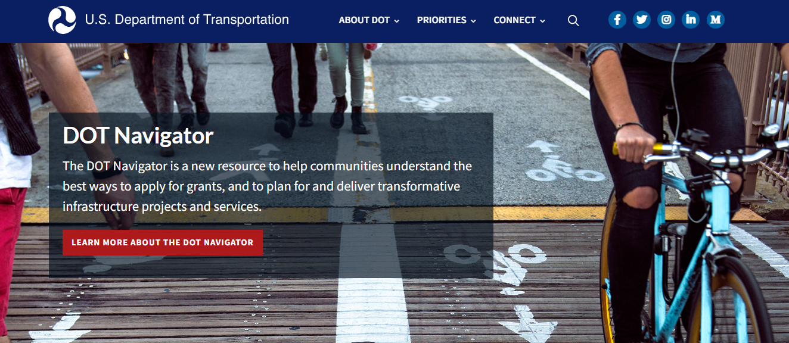
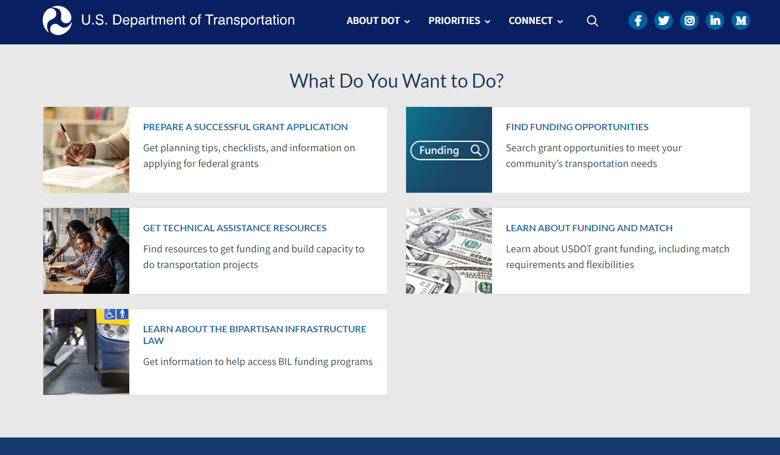
DOT Navigator
Coordinating and Improving Access to the range of DOT Technical Assistance Resources
https://www.transportation.gov/dot-navigator
Sample Grant Application Resources
Overview of DOT Funding and Financing FY23 Discretionary Grant Preparation Checklist Understanding Federal Match Requirements Federal tools to Determine Disadvantaged Community Status Maximizing Award Success Is Federal Funding the Right Fit for My Organization? Apply at www.Grants.gov
Notes:
Landing Page (billaunchpad.com)

Slide 8
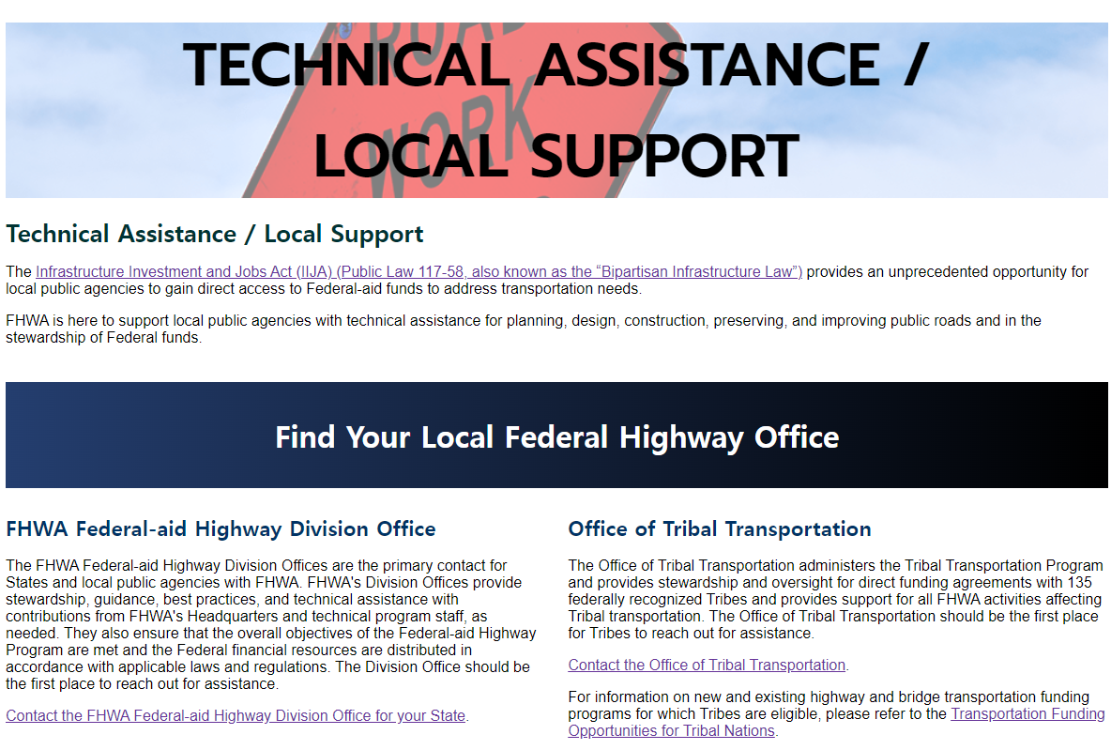
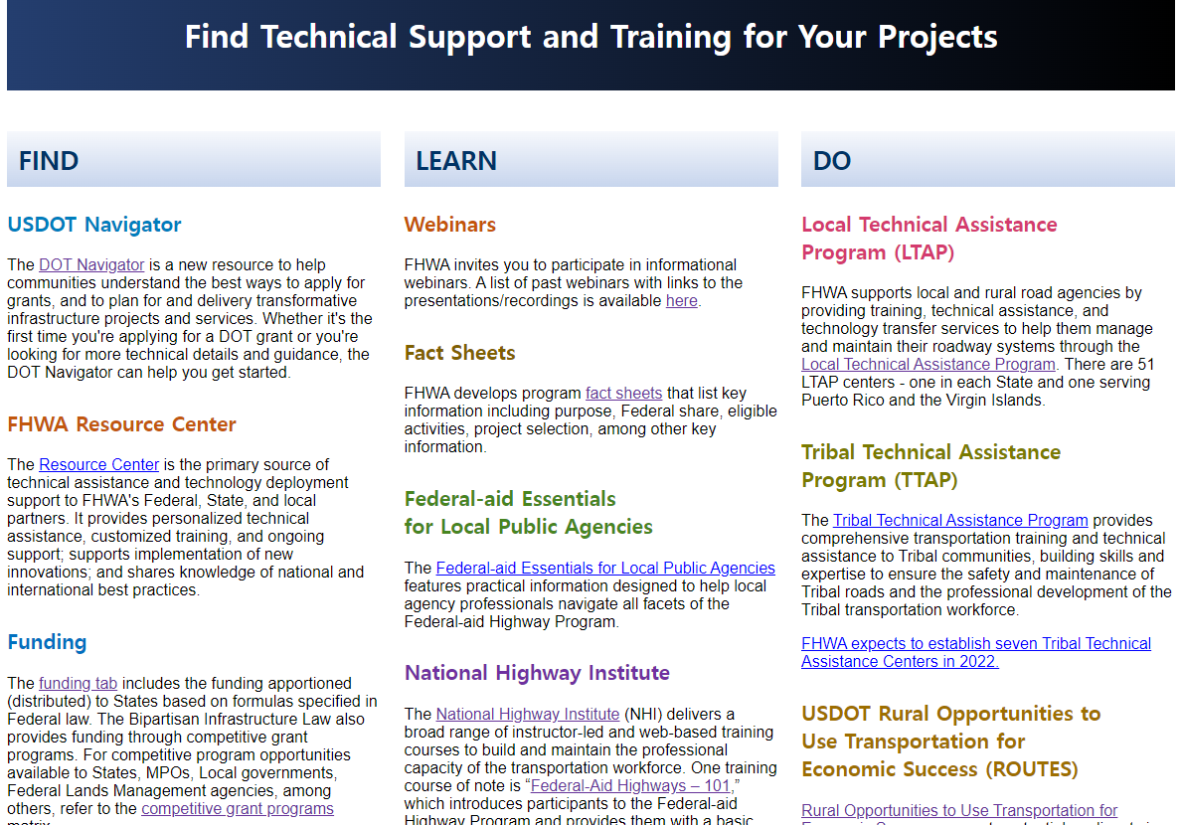
New to the Transportation Federal-aid Program?
Visit the FHWA BIL Technical Assistance / Local Support page at:
https://www.fhwa.dot.gov/bipartisan-infrastructure-law/technical_support.cfm
Information Provided
Federal-aid Division websites and contacts Office of Tribal Transportation information FHWA Resource Center information Local/Tribal Technical Assistance Programs National Highway Institute (formal training courses) A vast array of video shorts explaining the Federal-aid program
Notes:
National Highway Institute : Course Description for Understanding the Uniform Guidance Requirements (2 CFR 200) for Federal Awards - FHWA-NHI-231034 (dot.gov)

Slide 9
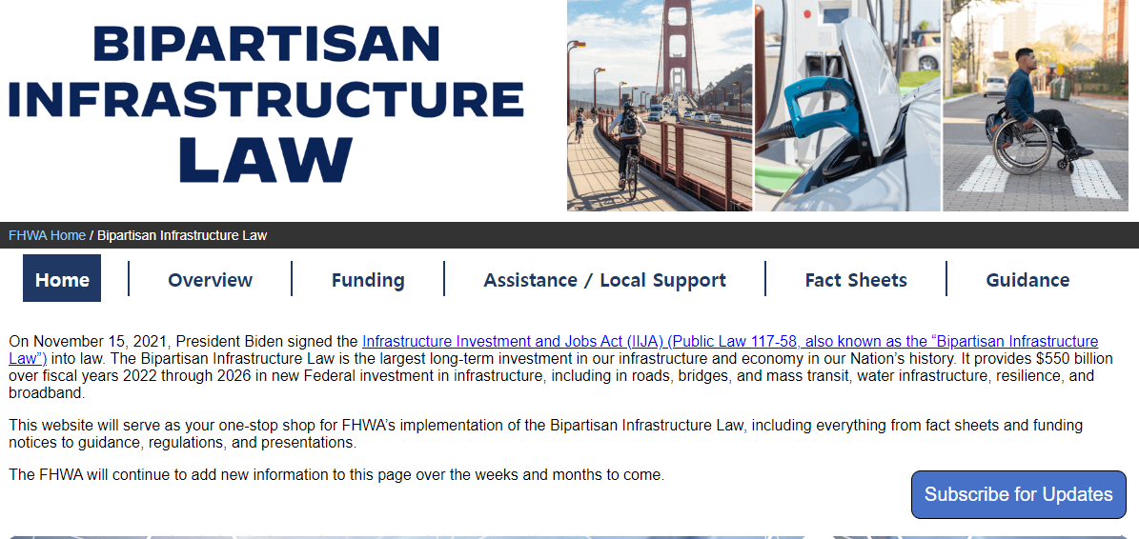
Staying engaged & informed through e-mail
Subscribe for updates at FHWA’s main BIL website:
https://www.fhwa.dot.gov/bipartisan-infrastructure-law/

Slide 10
THANK YOU
fhwa.dot.gov/bipartisan-infrastructure-law
Andrea Gutierrez
LPA & Grants Program Manager
Andrea.Gutierrez@dot.gov
775-687-5334

